Slide 1
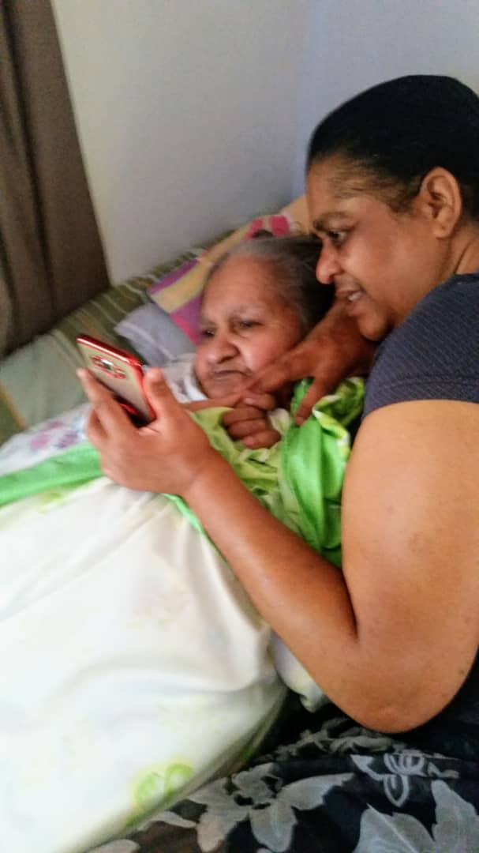
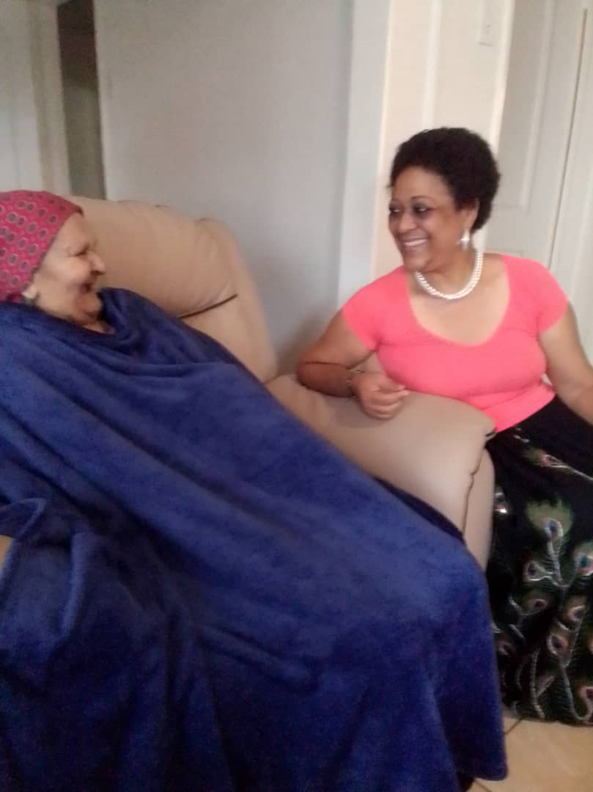
TAKE CHARGE IN YOUR TIME: ANECDOTE OF A FAMILY CARE GIVER OF AN OLDER ADULT
Rebecca Nthogo Lekoko
Defence Command and Staff College
&
Ageless Inspirations Charitable Organization
Phone: +267 72280881
E-mail: lekokorn@gmail.com

Slide 2
Older Persons in Botswana: General Characteristics
The population of older is projected to be 20% of the total population of Botswana in 2050, (National Census 2011).
There are gaps in their care as revealed by the rapid situational analysis of older adults' health conducted in 2019 by the Ministry of Health and supported by WHO. (WHO, 2022)
https://www.afro.who.int/countries/botswana/news/botswana-be-better-place-grow-old

Slide 3
Older Persons among vulnerable groups in Botswana
Vulnerable sections of the population in Botswana “include the elderly and people with disabilities, orphans and vulnerable children (OVC), people who suffer combinations of health and nutritional threats including HIV and tuberculosis, poor pregnant and lactating women and their infant children, and those who depend on marginal agricultural livelihoods subject to unreliable rainfall and veterinary hazards”(Regional Hunger and Vulnerability Programme, 2011)

Slide 4
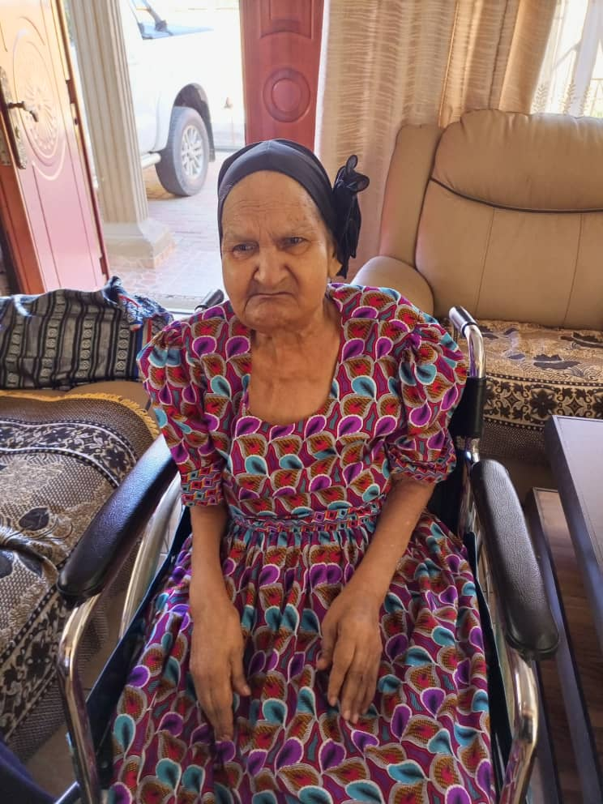
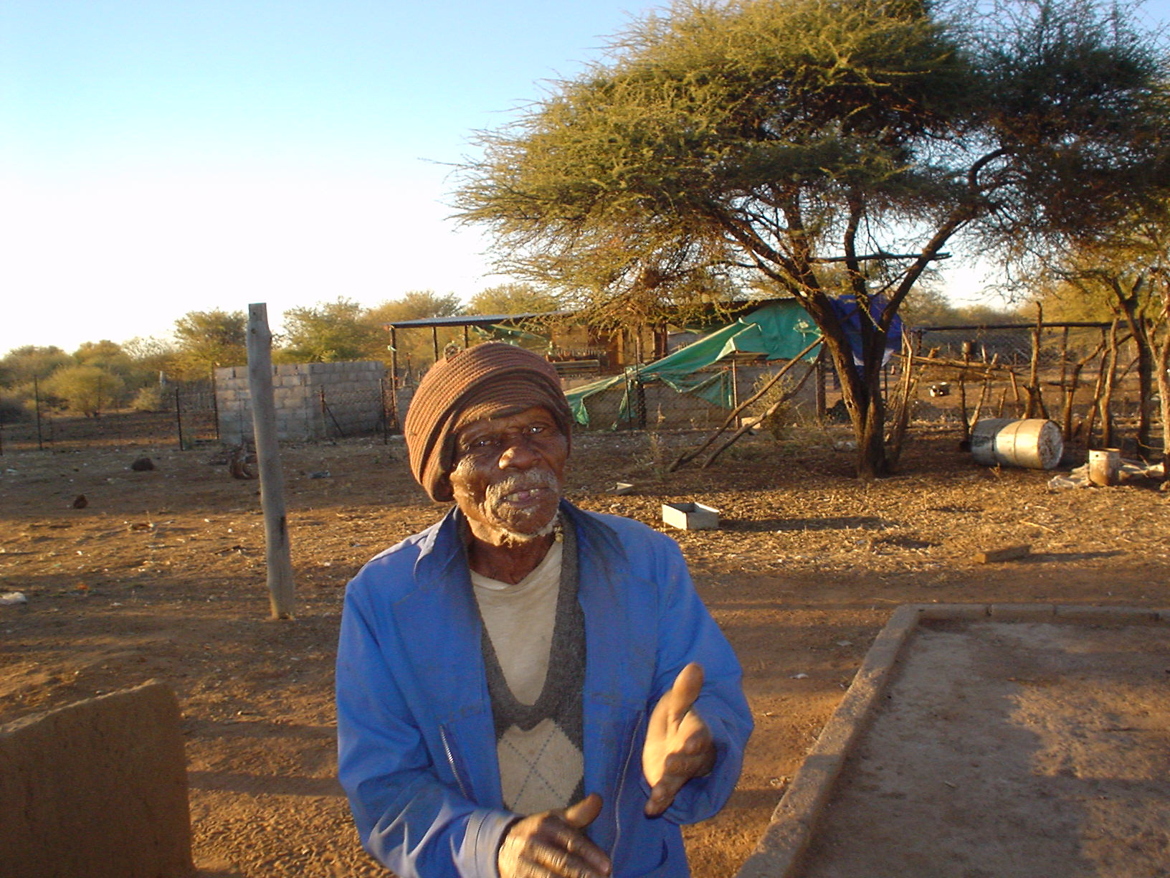
Older Persons’ Vulnerabilities
Lack of policy specifically addressing older peoples’ issues
No specific law to protect the rights of older adults
Health systems are not aligned with the needs of older adults
Health care system is integrative in nature but does not have data disaggregated enough for the health status of older adults to be monitored
Frequent loss of memory identified, significant impairment and disabilities among this population
High poverty level: only 9% above the poverty datum line
Victims of allegations of witchcraft
Unhealthy eating habits (WHO 2022).

Slide 5
Disaggregated Data on Socio-Economic Status of Older persons
A number of studies have been done and below are examples Number of Older Adults by Age Groups: Statistics Botswana 2014 Percentage age distribution by gender and type of residence: Statistics Botswana (2014). Educational attainments of older adults: Census 2011 & 2019 Older Adult share of wealth status by marital status Older adult living arrangement by Residence: Census 2011 and 2019 Older adult’s relationship with helper: 2019 Survey Older adults with disabilities: Statistics Botswana 2018 Older adults’ freedom of mobility: 2019 Survey Older adults’ memory problems: 2019 Survey Lighting Mode for 65-Year-Old: Statistics Botswana 2018 Cooking mode for population aged 65 years and above: Census 2011

Slide 6
Care of Older Persons
Provisions of social services (Government)
Provision of free medical services to older adults
Community-home based care (provided to very ill individuals)
National policy on destitute persons (all-encompassing including older persons – poor and destitute individuals who are unable to work )
The remote area dweller programme (RADS) (all-encompassing including older persons)
Vulnerable group feeding (e.g. adults at nutritional risk but all-encompassing including older persons)
One of the recommendation of the 2019 Situation Analysis of Ageing and Health of Older Adults in Botswana’ is to establish rehabilitation and a system of long term care for older adults at primary care levels.

Slide 7
Institutional Framework and Programs Addressing Neglect,
Abuse and Violence Against Older Persons
None and currently using systems such as customary law (traditional Kgotla disciplinary approach); the Police or intervention of other family members
One of the recommendation of the 2019 inter-sectoral one,’ Situation Analysis of Ageing and Health of Older Adults in Botswana’ led by the Ministry of Health and Wellness is the need to enact Protection Law (9.2).

Slide 8

ANECDOTE OF A FAMILY CARE GIVER
A culture still exists of family members providing care and support to older adults; primarily “because you [an older parent] have taken care of me to grow teeth, I will take care of you until your teeth fall out” – an African proverb (Agyenmang, 2021).
“African cosmos is like a spider web: its least elements cannot be touched without making the whole vibrate” (Etieyibo, 2016)

Slide 9
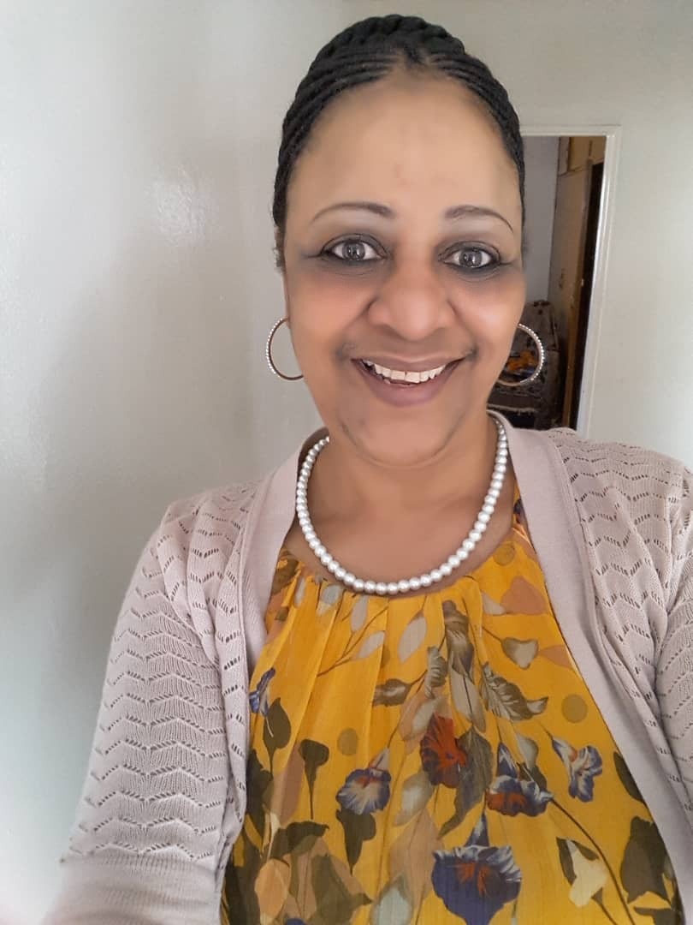

Anecdote Conti…
A cheerful caregiver with a strong self-determination
Caring with purpose
Having moral comfort to care for a mother with dementia
Faith in God keeps her strong
Mirrored challenges like financial constraints, sporadic visits by home-based care people
Misplaced consciousness by uncles taking advantage of her old mother’s dementia to steal her livestock and other properties

Slide 10
Way Forward to Care of Older Persons
Myths and stereotypes about older adults
National Development Plan 11 makes reference to the need for resilience ageing
Botswana Long Term Vision 2016 - no-one should be discriminated on any basis, be it gender, age, ethnicity, or any background
Long Term Vision 2036 reiterated the non-discriminatory virtue and maps an inclusive development path in which every Motswana will be empowered to meaningfully participate in the development of the country.

Slide 11

Conclude

